Slide 1
UNIT-II
Topics to be covered
1.Introduction to data structures.
2. Abstract data type (ADT)
3. Stacks
4. Queues
5. Circular queues and their implementation with arrays.
6. Stack applications:
6.1. infix to post fix conversion
  6.2. postfix expression evaluation.
  7. Applications of queues

Slide 2
Introduction to data structures
Data- it is a collection of facts or figures.
Type- it is a collection of values.
ex- integer- 0 to 9
boolean- true or false
Data type- it is a data of type and together with the set of operations used to apply on the type.
ex- integer is a member of type integer and its operations are addition, subtraction etc…

Slide 3
Definition:- a data structure is a Specific way to store and organize data in a computer’s memory so that these data can be used efficiently later.
Objective of data structure:- manipulation of real-life data requires the following essential tasks-
1.storage representation of user data
2. Retrieval of stored data
3. transformation of user data

Slide 4
DS
Mathematical definition of data structure is D=(d,f,a)
where
D= data structure
d= a set of variables (data objects).
f= a set of functions
a= set of rules to implement the functions.

Slide 5
Overview of data structures
Several data structures are available in the computer science and used based on their applications.
Data structures are classified into different types.
Data structure
Built-in Data structure
User defined Data structure
Integer
Float
Character
Linear ds
Non Linear ds
Arrays
Linked list
stack
queues
Trees
Graphs

Slide 6
1.Linear data structure-
All the elements are stored in sequential order or linear order means that all the elements are adjacent to each other. Each element has exactly two neighbors. Predecessor and successor.
The first element does not have predecessor
The last element does not have successor.
2. Non linear data structure- no such sequence in elements, if one element is connected to a more than two adjacent element then it is a non linear data structure.

Slide 7
Applications of data structures
Implementing data bases of different organizations (ds used is B-Trees)
Implement compilers for different languages (ds used is hash tables).
Used in every program and software system.

Slide 8
Abstract data type (ADT)
Data structure is implemented around the concept of an abstract data type that defines the data together with the operations.
ADT contains
- data
- operations
- no implementation details.
ADT is also called as user defined data type.
Only tells about what are the data values required and what operations performed on those objects.
Notes:
ADT: We think about what can be done with the data, not how it is done

Slide 9
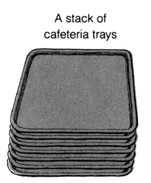
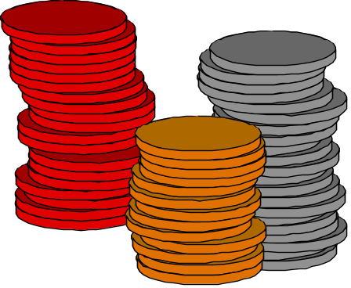

3. Stacks and queues
Definition - A stack is an ordered collection of homogeneous data elements, where the insertion and deletion takes place at one end, known as TOP.
The stack is also called LAST IN FIRST OUT(LIFO)
It means: the element which is inserted last must be deleted first
Example
1. No of plates in cafeteria
2. stack of coins

Slide 10
Stack maintains a pointer called top, which keeps track of the top most element in the stack.
Any insertions or deletions should be based upon the value of top.
It works on the basis of LIFO (Last in First out).
According to the definition, new elements are inserted from top and the elements are deleted from same end i.e again top.
This suggests that the element inserted most recently can only be deleted.
In the stack, the elements are removed in the reverse order of that in which they were added to the stack i.e last element inserted is to be deleted first.
So it is called last in first out.
Stack has structured with two operations
push- insertion\ adding elements on to a stack
Pop- deletion \ removing element from the stack

Slide 11
Basic operations:
The basic operations are insertion, deletion ,display.
In stacks, special terms are given for insert and delete. i.e push for insert and pop is for delete.
Push: inserting or adding element into the stack is called push.
Pop: deleting or removing element from the stack is called pop.
Traverse/display : To display an items
isFull : To know whether the stack is full or not
isEmpty : To know whether the stack is empty or not

Slide 12
Example 1:
When the elements are inserted in the order as A,B,C,D then the size
of the stack is 4 and the top most element in the stack is D.
When deletion operation is performed on stack continuously then the order in which the elements are deleted is D,C,B,A.
D
top
B
top
C
top
C
B
B
A
top
A
A
A
C
top
B
B
top
A
A
A
top

Slide 13
Example 2: Here Stack Size is 4
3
3
3
2
2
2
1
1
TOP->
1
20
0
TOP->
0
10
0
10
TOP = -1
(Empty stack)
Push 10
Push 20
TOP->
TOP->
3
3
3
40
40
TOP->
2
30
2
30
2
30
1
20
1
20
1
20
0
10
0
10
0
10
Push 30
Push 40
Push 50
(Overflow)

Slide 14
3
3
TOP->
2
2
30
1
20
TOP->
1
20
0
10
0
10
pop
pop
3
3
2
2
1
1
TOP->
0
10
0
pop (TOP = -1)
underflow
pop

Slide 15
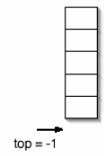
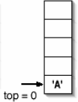


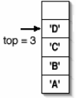
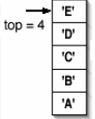
Elements are inserted in the order as A,B,C,D,E
It represents the stack of 5 elements.
The top most element in the stack is E
If we want to delete element E has to be deleted first

Slide 16
Pop operation- delete element from the stack

Slide 17
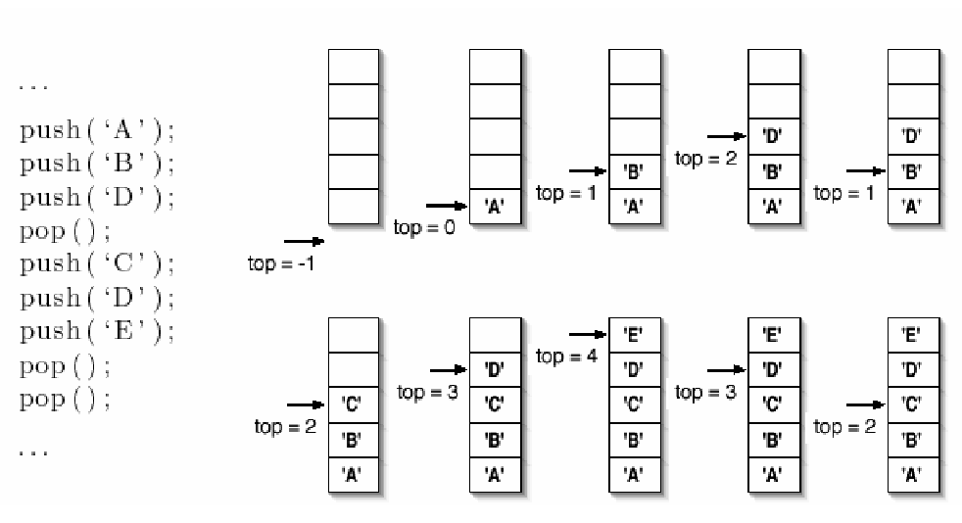
Example :-

Slide 18
ADT For Stack
ADT for stack
struct stack
{
int stack[5],top;
}
void push();
void pop();
void display();

Slide 19
Implementing stack using arrays
Algorithm for inserting element into the stack:
Algorithm push()
if top=(SIZE-1)
then write (‘stack overflow’)
else
read item or data
top←top+1
stack[top]← item
stop

Slide 20
Explanation:
The stack is of size max. This procedure inserts an element item on to the top of a stack which is represented by an array stack.
The first step of this algorithm checks for an overflow condition.
Overflow means inserting element into a stack which is full.
If the top value reaches to maximum size of the stack then elements cannot be inserted into the stack i.e. stack is full.
Otherwise top is incremented by one and element is inserted into the stack.

Slide 21
Algorithm to delete elements from the stack:
Algorithm pop()
if top=-1
then write (‘stack underflow’)
else
item ← stack[top]
top ← top-1

Slide 22
Explanation:
This procedure deletes an element from the stack.
The first step of this algorithm checks for underflow condition.
If the top value is -1 then stack is empty.
Empty stack is known as underflow.
Takeout the element from the location where, the top is pointing and then decrement top by one.

Slide 23
Display of stack:
Printing the contents of stack after push and pop operations.
Algorithm print()
if top=-1
then write (‘stack empty’)
else
Repeat for i ← top to 0
print(stack[i])
stop

Slide 24
/*1.Write a C program that implement stack and its operation by using the arrays.*/
#include<stdio.h> #include<stdlib.h> #define SIZE 4
void push(); void pop(); void display();
void isFull(); void isEmpty();
int top=-1,stack[SIZE],item;
void main()
{
int ch;
while(1) {
printf(" *** MENU ***\n 1. PUSH\n 2. POP\n 3.TRAVERSE\\DISPLAY\n 4.isFull\n 5.isEmpty\n 6.EXIT\n");
printf("enter your choice from menu:");
scanf("%d",&ch);
switch(ch) {
case 1 : push(); break;
case 2 : pop(); break;
case 3 : display(); break;
case 4 : isFull(); break;
case 5 : isEmpty(); break;
case 6 : exit(0);
default : printf("wrong choice\n");
}//switch
}//while
}//main

Slide 25
void push() {
if(top==SIZE-1)
printf("*** stack overflow(full) ***\n");
else
{
printf("enter the item to be pushed into the stack:");
scanf("%d",&item);
top++;
stack[top]=item;
}
}//push
void pop() {
if(top==-1)
printf("*** stack is empty ***\n");
else
{
item=stack[top];
top--;
printf("the deleted item from stack is %d\n",item);
}
}//pop

Slide 26
void isEmpty()
{
if(top==-1)
printf("Stack is empty\n");
else
printf("Stack is not empty\n");
}
void isFull()
{
if(top==SIZE-1)
printf("Stack is full\n");
else
printf("Stack is not full\n");
}
void display()
{
int i;
if(top==-1)
printf("**** stack underflow****");
else
{
printf("*** stack display ***\n");
for(i=top;i>=0;i--)
printf("%5d",stack[i]);
}
}

Slide 27
Queues
A queue is a linear data structure in which insertion take place from one end called rear end and deletions take place from other end called front end i.e insertion and deletion take place from different ends.
The principle used to in queue is FIFO.(First In First Out)
FIFO- the element which is inserted First must be deleted First.
In a queue there are two variables one is the rear and other one is front.
the element must be always added at rear end and removed from the front.
Basic operations on queue:
The operations that can be performed on queue are
Insertion\ Enqueue
Deletion\ Dequeue
Display
Front
rear

Slide 28







Bus Stop Queue
Bus Stop
front
rear
rear
rear
rear
rear

Slide 29
Bus Stop Queue
Bus Stop
front
rear
rear
rear

Slide 30
Bus Stop Queue
Bus Stop
front
rear
rear

Slide 31

Bus Stop Queue
Bus Stop
front
rear
rear

Slide 32
A queue is like a line of people waiting for
a bank teller. The queue has a front and a rear.
Rear
Front
Front
Rear
New people must enter the queue at the rear.
Front
Rear
When an item is taken from the queue, it always comes from the front.
Notes:
When you think of a computer science queue, you can imagine a line of people waiting for a teller in a bank. The line has a front (the next person to be served) and a rear (the last person to arrive.

Slide 33
This type of data structure is used in time sharing systems where many user jobs will be waiting in the system queue for processing. These jobs may request the services of CPU, main memory or external devices such as printer.

Slide 34
Working of a linear queue:-
i) Initially front=rear= -1. It indicates queue is empty.
0
1
2
3
4
front=rear=-1
ii) Add 10
iii) Add 20
0
1
2
3
4
0
1
2
3
4
10
10
20
front rear
front rear
iv) Add 30
v) Add 40
0
1
2
3
4
0
1
2
3
4
10
20
30
10
20
30
40
front rear
front rear

Slide 35
vi) Add 50
vii) Add 60 (overflow)
0
1
2
3
4
0
1
2
3
4
10
20
30
40
50
10
20
30
40
50
front rear
front rear
viii) delete (10 is removed)
ix) delete (20 is removed)
0
1
2
3
4
0
1
2
3
4
20
30
40
50
30
40
50
front rear
front rear

Slide 36
x) delete (30 is removed)
xi) delete (40 is removed)
0
1
2
3
4
0
1
2
3
4
40
50
50
front rear
front rear
xii) delete (50 is removed)
ix) delete (underflow)
0
1
2
3
4
0
1
2
3
4
front=rear=-1
front=rear=-1

Slide 37
Implementation of queue using array
Explanation:
This procedure adds an element item to the queue.
First it checks for an overflow condition.
If the rear value reaches or exceeds size of the queue
then elements cannot be inserted into the queue.
ie. Overflow.
Whenever element is inserted into the queue,
rear is increment by one
and place the element in the location
where rear is pointing.
Algorithm insert( )
if rear ≥ size-1
then write (‘overflow’)
else
Read item
rear← rear + 1
queue[rear]← item
if(front==-1)
front++;
stop

Slide 38
Algorithm to delete element from the queue
Algorithm delete()
if (front= = -1)or (front> rear)
then write (‘queue underflow’)
else
item ← queue [front]
front ← front + 1
Explanation:
This procedure deletes an element from the queue.
The first step of this algorithm checks for underflow condition.
If the front value is -1or greater than rear then queue is empty.
Take out the element from the location where, the front is pointing and
store it in the variable, then increment front by one.

Slide 39
Algorithm to display elements in a queue
if((front==-1)||(front>rear))
print queue is Underflow
else
repeat for i->front to rear
print queue[i];
Drawback in queue
In a queue when the rear pointer reaches to the end of the queue,
insertion would be denied even if room is available at the front
one way to remove this is using the circular queue

Slide 40
/*2. Write a C program that implement Queue and its operations using the arrays*/
#include<stdio.h> #include<stdlib.h> #define size 4
void insertion(); void deletion(); void display();
int front=-1,rear=-1,item,queue[size];
void main() {
int ch;
while(1) {
printf("\n*** MENU ***\n 1. INSERTION\n 2. DELETION\n 3.TRAVERSE\n 4. EXIT\n");
printf("enter your choice:");
scanf("%d",&ch);
switch(ch) {
case 1 : insertion();
break;
case 2 : deletion();
break;
case 3 : display();
break;
case 4 : exit(0);
default : printf("*** wrong choice ***\n");
}//switch
}//while
}//main

Slide 41
void insertion() {
if(rear==size-1)
printf("*** queue is full ***\n");
else {
printf("enter item into queue:");
scanf("%d",&item);
rear++;
queue[rear] = item;
if(front = = -1)
front++;
}//else
}//insertion
void deletion() {
if((front = = -1)||(front>rear))
printf("*** queue is empty ***\n");
else
{
item = queue[front];
front++;
printf("the deleted item from queue is %d\n",item);
}//else
}//deletion
void display() {
int i;
if((front = = -1)||(front>rear))
printf("*** queue is empty ***\n");
else {
printf("\n elements in queue:- ");
for(i=front;i<=rear;i++)
printf("%d ",queue[i]);
}//else
}//display

Slide 42
Types of Queues
  Linear Queue
  Circular Queue
  Double Ended Queue
  Priority Queue
Linear Queue: It is the one in which the insertions are takes place at rear end and deletions are takes place at front end.
Circular Queue: It is a linear data structure in which the operations are performed based on FIFO (First In First Out) principle and the last position is connected back to the first position to make a circle.
Double Ended Queue: It is a homogeneous list of elements in which insertion and deletion operations are performed from both the ends. They are also called as deque.
There are two types of deques:
Input-restricted deques and Output-restricted deques
Priority Queue: In priority queues, the items added to the queue have a priority associated with them which determines the order in which they exit the queue. Items with highest priority are removed first.

Slide 43
Circular queues
Q[1]
Q[2]
Q[3]
Q[N]
Q[0]
Circular Queue is a linear data structure in which the operations are performed based on FIFO (First In First Out) principle and the last position is connected back to the first position to make a circle. It is also called ‘Ring Buffer.
It is the one in which the insertion of a new element is done at the very first location of the queue if the last location of the queue is full. i.e. circular queue is one in which the first element comes just after the last element.
A circular queue overcomes the problem of unutilized space in linear queues implemented as arrays.
A circular queue also have a Front and Rear to keep the track of elements to be deleted and inserted and therefore to maintain the unique characteristic of the queue.
Examples:
Print spooler of operating system
Revolvers bullet cylinder

Slide 44
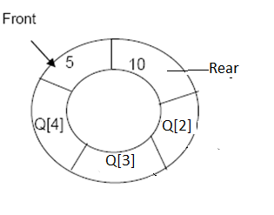
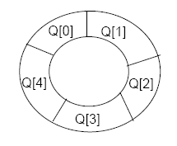
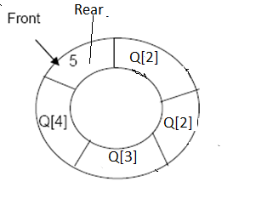
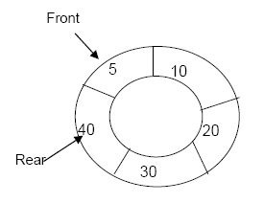
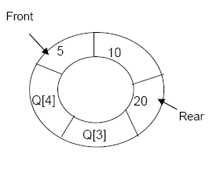
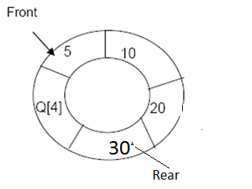
Circular queues
Front=-1 rear=-1
Empty queue
Insert element 5
Insert element 10
Insert element 40
Insert element 30
Insert element 20

Slide 45
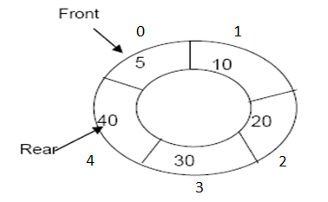
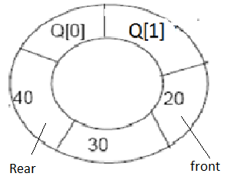
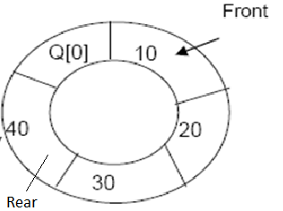
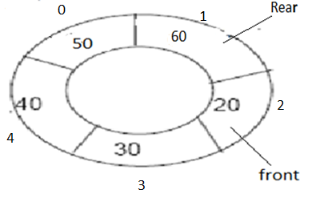
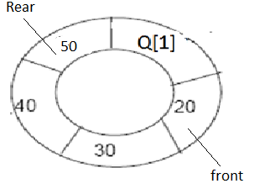
Delete element 5
Delete element 10
Insert element 60
Insert element 50

Slide 46
How to test whether circular queue is empty or full?
The circular q is controlled by the MOD operation.
Circular queue is empty
when front =-1
rear=-1
Circular queue is full
front = (rear+1)% SIZE

Slide 47
Insertion Algorithm:
if front == (rear+1)%size
  then Queue is Overflow
  else
  Read item;
rear=(rear+1)%size
cq[rear] = item
if front==-1 then
front++
Stop
Deletion Algorithm:
if front = = -1
  Queue Underflow
else
delete item at cq[front]
If front = = rear
  front = -1;
  rear = -1;
else
front=(front+1)%size
Algorithm to Display :
if front == -1
  Queue is empty
  else
for(i=front ; i!=rear ; i=(i+1)%size)
print cq[i]
print cq[i]

Slide 48
/* Program for circular queue using array*/
# include<stdio.h> #include<stdlib.h> #define size 5
void insert();
void delete();
void display();
int cq[size], front = -1, rear = -1;
void main()
{
int ch;
while(1) {
printf(“\n1.Insert\n 2.Delete\n 3.Display\n 4.Quit\n");
printf("Enter your choice : ");
scanf("%d",&ch);
switch(ch){
case 1 :insert();
break;
case 2 :delete();
break;
case 3: display();
break;
case 4: exit(0);
default:printf("Wrong choice\n");
}/*End of switch*/
}/*End of while */
}/*End of main()*/

Slide 49
void insert()
{
int item;
if(front == (rear+1)%size)
{
printf("Queue Overflow \n");
}
else
{
printf("Input the element for insertion in queue : ");
scanf("%d", &item);
rear=(rear+1)%size;
cq[rear] = item ;
}
if(front==-1)
front++;
}

Slide 50
void delete()
{
int ele;
if (front == -1)
{
printf("Queue Underflow\n");
}
else
{
ele=cq[front];
printf("Element deleted from queue is : %d\n“,ele);
if(front==rear)
{
front=-1;
rear=-1;
}
else
front=(front+1)%size;
}
}/*End of del() */

Slide 51
void display()
{
int i;
if(front==-1)
{
printf("queue is empty");
}
else
{
printf("\n queue elements are:");
for (i=front ; i!=rear ; i=(i+1)%size)
printf(“%4d”,cq[i]);
printf(“%4d”,cq[i]);
}

Slide 52
example
1.encq(A)
2.encq(B)
3.encq(c )
4. Encq ( D )
5.Decq
6.encq(E)
7. Decq
8.encq( F)
9.Decq
10. Decq
11.Decq
12. Decq

Slide 53
Applications of stacks
Reverse of string
Conversion of decimal to binary
Parenthesis matching.
    Recursion.
Infix to prefix conversions.
Infix to postfix conversions.
Evaluation of postfix expressions.

Slide 54
Stack Applications
Page-visited history in a Web browser (call history in mobiles)
2) Undo sequence in a text editor
3) Recursive Functions
4)Saving local variables when one function calls another,
and this one calls another, and so on
5) Reversing Data: Very useful for finding palindromes.
6) Converting Decimal to Binary
7) Backtracking: Stacks can be used to backtrack to
achieve certain goals
8) Evaluating arithmetic expressions
- Infix to Postfix Conversion
- Postfix Evaulation

Slide 55
1.Parenthesis matching
The objective of this function is to check the matching of parenthesis in an expression
i.e
In an expression the no of left parenthesis must be equal to no: of right parenthesis.
Ex: ((A+B)*C)
This is a valid expression because in this no of left parenthesis (2) = no: of right parenthesis (2).

Slide 56
Conversion of expressions
Arithmetic expressions can be represented in three ways:
Infix notation
Prefix notation
Postfix notation
Infix notation- In which operator should be placed in between the two operands.
Example- A+B C-D E*F G/H.
2. Prefix notation (polish notation)-
Operator preceded by the operand is called prefix notation
Examples
+AB -CD *EF \GH.
3. Postfix notation(reverse polish notation or suffix notation)-
Operator should be placed after operands.
AB+ CD- EF* GH\

Slide 57
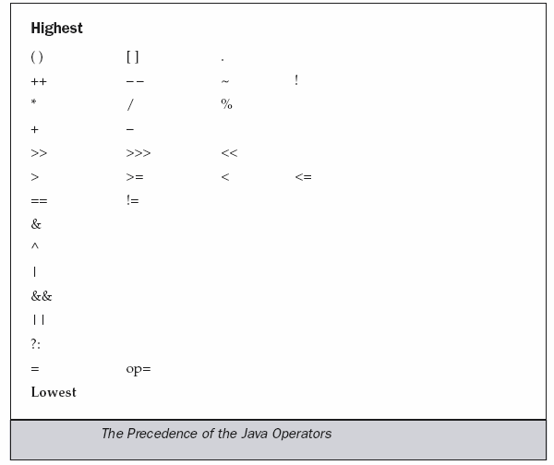
Operator Precedence

Slide 58
Notations – Conversions
Consider the infix expression: 2 + 3 * (5 – 7) / 9
Let us insert implicit parentheses
(2 + ((3 * (5 – 7)) / 9))
Transfer the operators to the beginning of parentheses
(+ 2 (/ (* 3 (– 5 7)) 9))
Remove the parentheses: + 2 / * 3 – 5 7 9
This is the equivalent prefix expression.
Transfer the operators to the end of parentheses
(2 ((3 (5 7 –) *) 9 /) +)
Remove the parentheses: 2 3 5 7 – * 9 / +
This is the equivalent postfix expression.

Slide 59
Examples
Infix Expression | Prefix Expression | Postfix Expression
2 + 3 | + 2 3 | 2 3 +
2 + 3 * 5 | + 2 * 3 5 | 2 3 5 * +
(2 + 3) * 5 | * + 2 3 5 | 2 3 + 5 *
2 * 3 – (5 + 9) | – * 2 3 + 5 9 | 2 3 * 5 9 + –

Slide 60
Convert infix to postfix expression
(A-B)*(D/E)
(A+B^D)/(E-F)+G
A*(B+D)/E-F*(G+H/K)
((A+B)*D)^(E-F)
(A-B)/((D+E)*F)
((A+B)/D)^((E-F)*G)
12/(7-3)+2*(1+5)
5+3^2-8/4*3+6
6+2^3+9/3-4*5
6+2^3^2-4*5
Evaluate the postfix expression
5,3,+,2,*,6,9,7,-,/,-
3,5,+,6,4,-,*,4,1,-,2,^,+
3,1,+,2,^7,4,1,-,2,*,+,5.-

Slide 61
Infix to post fix(RPN) Conversion
Algorithm to convert infix expression to RPN:
Declare a stack.
Read infix expression
Repeat the following steps until the end of the infix expression is reached.
  Get input token (constant, variable, arithmetic operator, left parenthesis, right parenthesis) in the infix expression.
  If the token is
    An operand: Display it.
    A left parenthesis: Push it onto the stack.
    A right parenthesis:
      Pop and display stack elements until a left parenthesis is on the top of the stack.
      Pop the left parenthesis also, but do not display it.
    An operator:
      While the stack is nonempty and token has lower or equal priority than stack top element, pop and display.
      Push token onto the stack.
When the end of the infix expression is reached, pop and display stack items until the stack is empty.(Note: Left parenthesis in the stack has lowest priority)

Slide 62
Note
1. the lower precedence operator never placed on top of the higher precedence.

Slide 63
INFIX TO RPN CONVERSION – DEMO
Expression:
Output:
3
*
(
9
–
2
)
+
5
Scan a token.
  3 is an operand.
  Display 3.
Scan next token.
  * is an operator.
  Push * onto stack.
Scan next token.
  ( --- left parenthesis.
  Push ( onto stack.
Scan next token.
  9 is an operand.
  Display 9.
Scan next token.
  – is an operator.
  Priority > that of (.
  Push – .
Scan next token.
  2 is an operand.
  Display 2.
Scan next token.
  ) --- right parenthesis.
  Pop until ( is got.
↑SCAN

Slide 64
INFIX TO RPN CONVERSION – DEMO
Expression:
Output:
3
9
2
–
+
5
8. Scan next token.
  + is an operator.
  Priority of + less than that of *
  Pop * and display.
  Stack is empty.
  Push +
9. Scan next token.
  5 is an operand.
  Display.
10. Scan next token.
  End of expression.
  Pop all elements and display.
↑SCAN
*

Slide 65
An Example: 7-(2*3+5)*(8-4/2) → 723*5+842/-*-
Remaining Infix String Stack Postfix String
7-(2*3+5)*(8-4/2) empty null
-(2*3+5)*(8-4/2) empty 7
(2*3+5)*(8-4/2) - 7
2*3+5)*(8-4/2) -( 7
*3+5)*(8-4/2) -( 72
3+5)*(8-4/2) -(* 72
+5)*(8-4/2) -(* 723
5)*(8-4/2) -(+ 723*
)*(8-4/2) -(+ 723*5
*(8-4/2) - 723*5+
(8-4/2) -* 723*5+
8-4/2) -*( 723*5+
-4/2) -*( 723*5+8
4/2) -*(- 723*5+8
/2) -*(- 723*5+84
2) -*(-/ 723*5+84
) -*(-/ 723*5+842
null empty 723*5+842/-*-

Slide 66
Infix expression- (A+B)^C-(D*E)/F
Infix | Stack | Post fix
( | ( | Empty
A | ( | A
+ | (+ | A
B | (+ | AB
) | Empty | AB+
^ | ^ | AB+
C | ^ | AB+C
- | - | AB+C^
( | -( | AB+C^
D | -( | AB+C^D
* | -(* | AB+C^D
E | -(* | AB+C^DE
) | - | AB+C^DE*
/ | -/ | AB+C^DE*
F | -/ | AB+C^DE*F
 | Empty | AB+C^DE*F/-

Slide 67
/*3i).Write a C program that uses stack operations to perform convertion of infix expression into postfix expression.*/
#include<stdio.h>
#include<ctype.h>
#include<string.h>
void push(char);
char pop();
int priority(char);
char stack[30];
int top=-1;
void main()
{
char in[30],post[30],ch;
int i,j,len;
printf("\n Enter the string(Infix Expression): ");
gets(in);
len=strlen(in);
printf("\n The length of the given string is: %d\n",len);

Slide 68
for(i=0,j=0;i<len;i++)
{
if(isalpha(in[i]) || isdigit(in[i]))
post[j++]=in[i];
else if(in[i]=='(')
push(in[i]);
else if(in[i]==')')
{
while((ch=pop())!='(')
post[j++]=ch;
}
else
{
while(priority(in[i])<=priority(stack[top]))
post[j++]=pop();
push(in[i]);
}
}//for
while(top!=-1)
{ post[j++]=pop(); }
post[j]='\0';
printf("\nEquivalent infix to postfix is:%s ",post);
}//main

Slide 69
int priority (char c)
{
switch(c)
{
case '+':
case '-': return 1;
case '*':
case '/': return 2;
case '^': return 3;
default: return 0;
}//switch
}//priority
void push(char c)
{
top++;
stack[top]=c;
}//push
char pop()
{
char c;
c=stack[top];
top--;
return(c);
}

Slide 70
Postfix (reverse polish notation) expression evaluation
Algorithm
1.Scan expression from left to right and repeat steps 2 and 3 for each element of expression.
2. If an operand is encountered, put it on stack.
3.If an operator op1 is encountered then
3.1 remove the top two elements of stack, where A is the top and B is the next top element.
3.2 evaluate B op1 A
3.3 push the result back on to the stack.
4. set the top value on stack.
5. stop

Slide 71
EVALUATION OF RPN EXPRESSION – DEMO
Expression:
Scan a token.
  2 is an operand.
  Push 2 onto stack.
Scan next token.
  4 is an operand.
  Push 4 onto stack
Scan next token.
  * is an operator.
  Pop from stack --- 4.
  Pop from stack --- 2.
  Apply * on the operands.
  Push result 8 onto stack.
Scan next token.
  9 is an operand.
  Push 9 onto stack.
2
4
*
9
5
+
–
↑SCAN
8
Top →

Slide 72
EVALUATION OF RPN EXPRESSION – DEMO
Expression:
Scan a token.
  2 is an operand.
  Push 2 onto stack.
Scan next token.
  4 is an operand.
  Push 4 onto stack
Scan next token.
  * is an operator.
  Pop from stack --- 4.
  Pop from stack --- 2.
  Apply * on the operands.
  Push result 6 onto stack.
Scan next token.
  9 is an operand.
  Push 9 onto stack.
Scan next token.
  5 is an operand.
  Push 5 onto stack.
Scan next token.
  + is an operator.
  Pop
  Pop
  Apply +
  Push result.
Scan next token.
  - is an operand.
  Pop, pop, apply -, push result.
5
+
–
↑SCAN
14
Top →
9
8

Slide 73
EVALUATION OF RPN EXPRESSION – DEMO
Expression:
Scan a token.
  2 is an operand.
  Push 2 onto stack.
Scan next token.
  4 is an operand.
  Push 4 onto stack
Scan next token.
  * is an operator.
  Pop from stack --- 4.
  Pop from stack --- 2.
  Apply * on the operands.
  Push result 6 onto stack.
Scan next token.
  9 is an operand.
  Push 9 onto stack.
Scan next token.
  5 is an operand.
  Push 5 onto stack.
Scan next token.
  + is an operator.
  Pop
  Pop
  Apply +
  Push result.
Scan next token.
  - is an operand.
  Pop, pop, apply -, push result.
–
↑SCAN
Top →
-6

Slide 74
EVALUATION OF RPN EXPRESSION – DEMO
Expression:
Scan a token.
  2 is an operand.
  Push 2 onto stack.
Scan next token.
  4 is an operand.
  Push 4 onto stack
Scan next token.
  * is an operator.
  Pop from stack --- 4.
  Pop from stack --- 2.
  Apply * on the operands.
  Push result 6 onto stack.
Scan next token.
  9 is an operand.
  Push 9 onto stack.
Scan next token.
  5 is an operand.
  Push 5 onto stack.
Scan next token.
  + is an operator.
  Pop
  Pop
  Apply +
  Push result.
Scan next token.
  - is an operand.
  Pop, pop, apply -, push result.
Scan next token
  End of expression
  Pop and display
↑SCAN
-6
Top →

Slide 75
Evaluate the expression
Postfix:- 5,6,2,+,*,12,4,/,-
Symbol scanned stack content
5 5
6 5 6
2 5 6 2
+ 5 8
* 40
12 40 12
4 40 12 4
/ 40 3

Slide 76
/*3ii).Write a C program that uses Stack operations to perform the evaluation of the postfix expression*/
#include<stdio.h>
#include<string.h>
#include<stdlib.h>
#include<math.h>
void push(int);
int pop();
int stack[15],top=-1;
void main()
{
char p[30],t[30];
int len,i,k,a,b,c,n;
printf("\n\n\nEnter the postfix:");
gets(p);
len=strlen(p);
for(i=0;i<len;i++)
{
k=0;
if(p[i]==' ')
continue;

Slide 77
else if(p[i]=='+‘ || p[i]=='-‘ || p[i]=='*‘ || p[i]=='/‘ || p[i]=='^')
{
a=pop(); b=pop();
switch(p[i])
{
case '+': c=b+a;
break;
case '-': c=b-a;
break;
case '*': c=b*a;
break;
case '/': c=b/a;
break;
case '^': c=pow(b,a);
break;
}
push(c);
}
else
{
while(p[i]!=' ')
{ t[k++]=p[i++]; }
t[k]='\0';
n=atoi(t);
push(n);
}
}//for
printf("\n\n\nResult=%d“,pop());
}//main

Slide 78
void push(int x)
{
stack[++top]=x;
}
int pop()
{
return(stack[top--]);
}

Slide 79
Applications of queues
There are several applications of queues in computer science
Implement various aspects of operating systems.
Operating System maintains a queue of processes that are ready to process or that are waiting for particular event to occur.
Computer system maintains a buffer for messages between two processes, two programs, or even two systems and is implemented as a queue
Round robin techniques for processor scheduling is implemented using queue
a file server in a computer network handles file access request from many clients throughout the network. Servers have a limited capacity to service request from clients. when that capacity is exceeded, client requests wait in queues
This type of data structure is used in time sharing systems where many user jobs will be waiting in the system queue for processing. These jobs may request the services of CPU, main memory or external devices such as printer
Call Center phone systems will use Queues, to hold people calling them in an order, until a service representative is free
All types of customer service software (like Railway/Air ticket reservation) are
designed using queue to give proper service to the customers
.
.

